Slide 1
Ching, E. W. K., Chiang, T. P., Wong, J. O., Siu, B. W., Lui, S. S., & Cheung, E. F. (2021). Validation of the Chinese Dimensional Anhedonia Rating Scale in Depressed Patients in Hong Kong. Psychological Test Adaptation and Development. http://doi.org/10.1027/2698-1866/a000012

Slide 2
Introduction
Anhedonia – inability to feel pleasure
«Pathological construct», extreme add on to other psychiatrich disorders
Reason why this is important is that it’s linked to poor outcomes in treatments (Downar et al., 2014; Uher et al., 2012, 2008; Vrieze et al., 2014, see Ching, E. W. K. et al., 2021, p. 1)
Validation of a remade DARS-scale in a chinese setting...
C-DARS

Slide 3
Conceptual Framework
ANHEDONIA
HOBBIES/PASTIME
INTEREST
INTEREST
FOOD AND DRINK
SOCIAL ACTIVITIES
SENSORY EXPERIENCE
MOTIVATION
EFFORT
PLEASURE
INTEREST
MOTIVATION
EFFORT
PLEASURE
INTEREST
MOTIVATION
EFFORT
PLEASURE
MOTIVATION
EFFORT
PLEASURE

Slide 4
Example Item from DARS
B. Please list at least 2 of your favorite foods or drinks:
5. I would make an effort to get/make these foods/drinks
6. I would enjoy these foods/drinks
7. I want to have these foods/drinks
8. I would eat as much of these foods as I could

Slide 5
Validation of Validation

Slide 6
Interpretation and uses of the test scores
DARS
Meant to be used as a self reported to measure severity of Anhedonia in patients, the test scores are meant to be used to inform treatment plans – evidence supporting the four factor structure has been done in a previous study, and convergent validity with another scale meant to measure the same thing (SHAPS) (Ching et al., p. 2).
C-DARS
Test score interpreted as to a degree of presence of anhedonia in a Chinese context

Slide 7
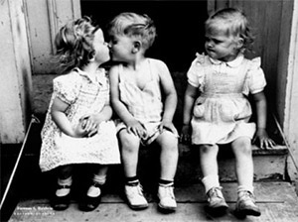
Notes:
So what do you do when you want something someone else has? Do you say, sod it Im gonna sit in my own truth and good things will come or...

Slide 8

Notes:
...do we imitate? We imitate. Use a validated scale for measuring the degree of anhedonia and see if it works in your own setting.

Slide 9

Relational Evidence
Test Criterion Validity: How accurately do test scores predict criterion performance? Or to what degree will C-DARS inform on test scores of a similar test?
By being friends with one person, can you predict that they’ll get along with your other friends?
SHAPS
DARS
C-DARS
Notes:
Concurrent research strategy; obtaining the criterion at the same time: SHAPS, also examining Anhedonia. So they examine if they’re related in that the validity of C-DARS is expressed by the correlation coefficient between SHAPS test score and C-DARS test score. DARS
Compare to predictive research strategy: Does the score predict the effect of treatment plan for adehonia?

Slide 10
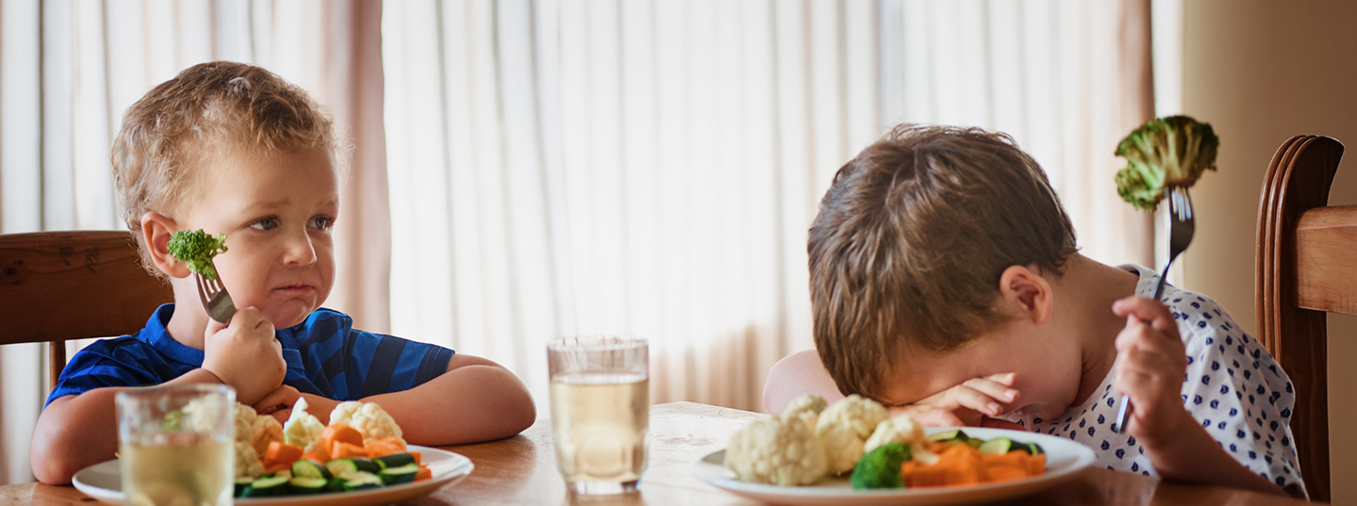
Discriminant Evidence Category
C-DARS
HAMD
HAMD
DARS
Used when examnining different traits and different methods so if we were to do a MTMM analysis, this would direct our attention to the Heterotrait-Heteromethod Triangle
Notes:
HAMD SCALE, examining depression; similar BUT different construct. Because treatment for depression not effective for anhedonia patients. So basically if a scale captures elements of depression in order to inform treatment then you’re setting your patient up to fail – not very good. And also, remember that anhedonia is not exclusive to depressed people

Slide 11
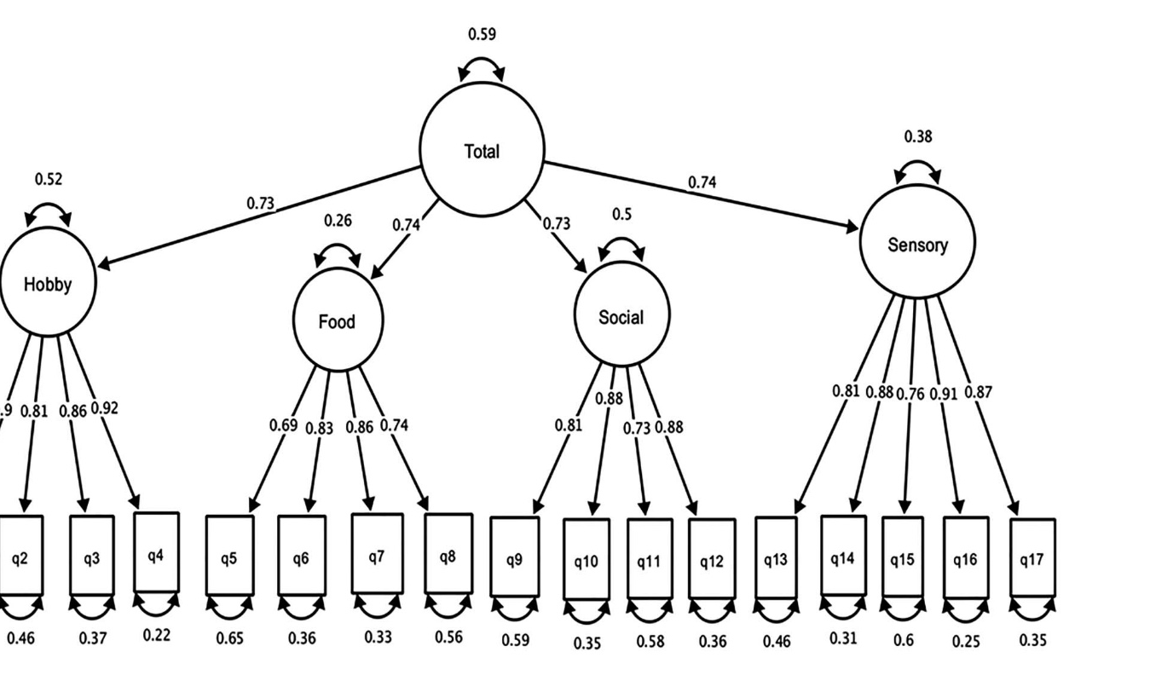
Structural Evidence
CFA: To test if the internal structure is that of the origianl DARS
Notes:
Is the model used for DARS, an adequate representation of your data? Is the four factor structure (remember the four factor structure) an adequate representation of your data?

Slide 12
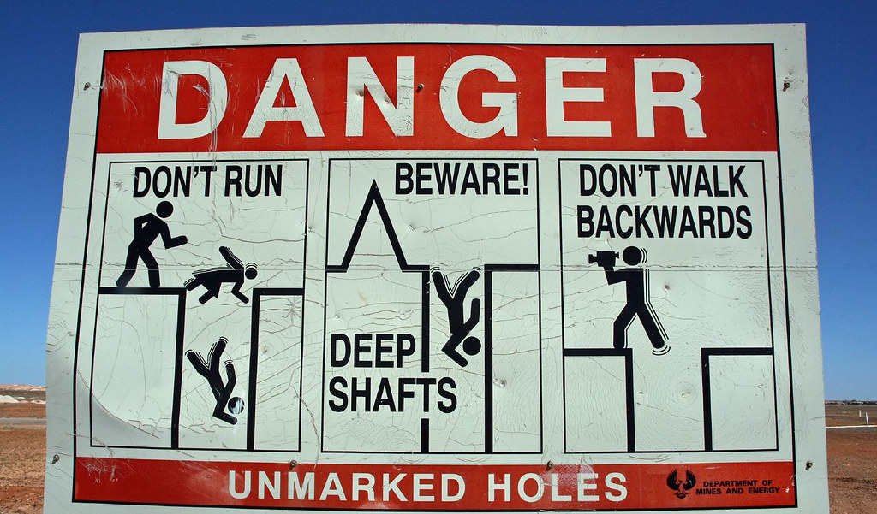
Content Based Evidence
The scale was developed by backward and forward translations and reviewed by an expert panel and a focus group
Experts: In order to make sure that the content of the Anhedonia construct is captured in the scale
Dette bildet av Ukjent forfatter er lisensiert under CC BY-NC-ND
Notes:
Experts: In order to make sure that the content of the Anhedonia construct is captured in the scale
Focus group: To make it culturally appropriate, they for example changed the bulletpoints to a numercial list

Slide 13
Results
Relational validity
Test Criterion Validity:
Concurrent test result: Shaps (-0.7 r)
Discriminant Validity:
Result: HAMD (-.34 r)
Structural Evidence
Goodness of Fit Index (GFI): 0.859
Root Mean Squared Error of Approximation (RMSEA): 0.078.
Content evidence
Got the thumbs up from their expert panel!
Notes:
GFI meaning comparing the estimated covariance matrix (the one the model predicts) to the observered covariance matrix.
The best value is zero. RMSEA meaning the average ratio of the probability of an observed value under the restrictions of the model, to its probability of being observed without restrictions

Slide 14
Valid?
How did the researchers wish to be able to interpret the test scores?
The presence and degree of anhedonia in patients in a Chinese context
Is the interpretation and usage supported by the evidence provided? In other words, is the interpretation and usage of test score valid?
GFI McDonald (1999, p. 89) results below the level of an acceptably fitted model. They call it Adequate in the paper.
RMSEA McDonald (1999, p. 171); larger than the recommendation. Recommended threshold 0.05
Notes:
Question (answer when going throuhg lecture): why not look at effectiveness in identifying the illness on informing treatment? Because it’s answered by the other study?
GFI according to McDonald (1999, p. 89) this is below the level of an acceptably fitted model. They call it Adequate in the paper. Again larger than the recommendation in McDonald (1999, p. 171).

